Slide 1
Installing LogicMail on a personal BlackBerry to access your AKO / DKO email
Presented by Michael J. Danberry
Information from:
http://www.logicprobe.org/proj/logicmail/wiki/setup10
Tweaked on: 12 December 2010

Slide 2
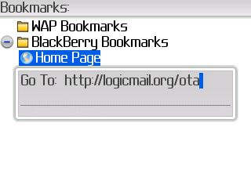
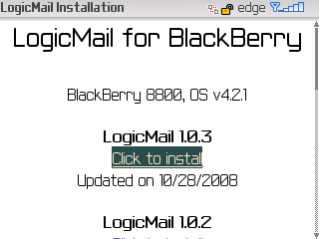
Visit http://logicmail.org/ota from your BlackBerry web browser
The webpage should display your device and OS version, Click the “Click to Install” link
LogicMail 1.1.0
Updated on 11/02/2009

Slide 3
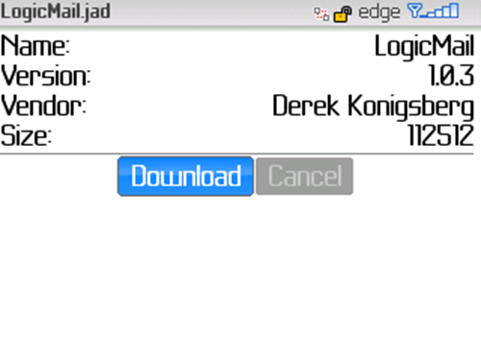
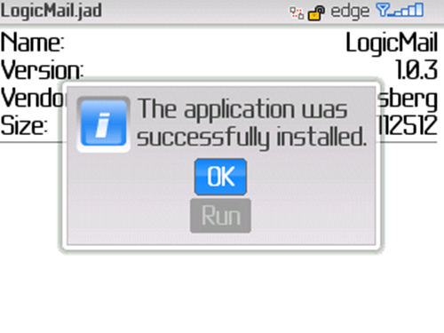
Click Download, then OK
1.1.0
1.1.0

Slide 4

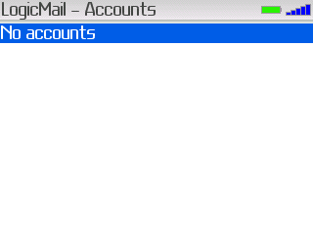
Find the LogicMail application icon to start LogicMail, an empty account screen will be displayed

Slide 5
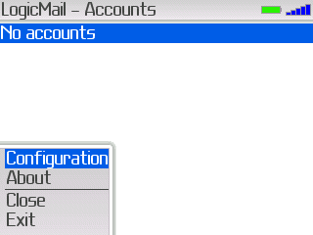
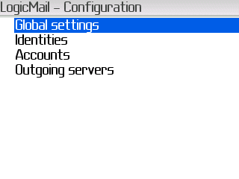
Go to the Menu, and select “Configuration” Global settings will be displayed next
1.
3.
2.

Slide 6
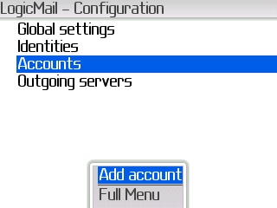
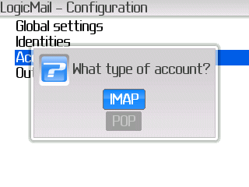
Go to “Accounts,” bring up the menu, and select “Add account,” Select “IMAP”
4.
6.
5.

Slide 7
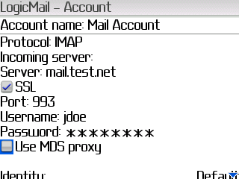
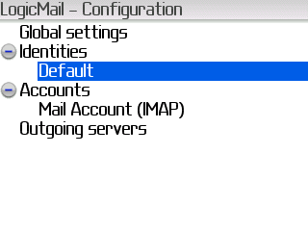
Change the settings to match your version of AKO mail
7.
Type in Mail Account
Regular AKO / DKO Email:
Incoming mail server: type: imap.us.army.mil
-or-
Advanced Technologies Email “Beta mail”
Incoming mail server: mail.beta.army.mil (Exchange 2010 users)
Incoming mail server: owa.beta.army.mil (Exchange 2007 users)
Username is your AKO username
Password is your AKO Password
Uncheck Use MDS proxy
13. Click on Save at the bottom of the screen
14. Select Default and go to the Edit Screen
8.
9.
Put a check in the SSL box
10.
11.
12.

Slide 8
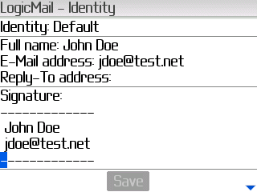
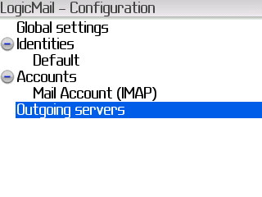
Add the following information into your BlackBerry
15. Type your name in the Full name line:
16. Type your AKO email address in the E-Mail address line & Reply address
17. You can add a signature if you’d like
19. Select Outgoing servers
18.
20. Add Outgoing Server

Slide 9
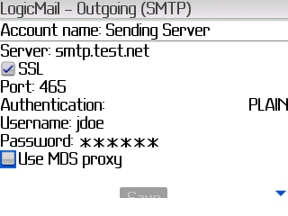
Add the following information into your BlackBerry
21.
Type in Sending Server
Regular AKO / DKO Email:
22. Outgoing mail server: mailrouter.us.army.mil
23. Put a check in the SSL box
Advanced Technologies Email “Beta mail”
Outgoing mail server: mailrouter.us.army.mil
24. Change Authentication to Plain
25. Username is your AKO Username
26. Password is your AKO Password
NOTE: Regular AKO email and Advanced Technologies will use AKO username and password.
Save
27.
Select Save when completed on this screen

Slide 10
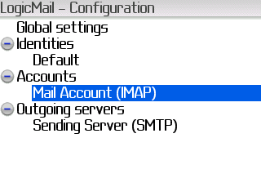
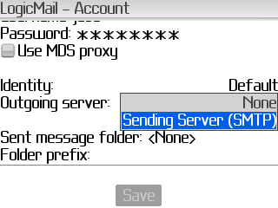
Scroll to the bottom to make sure that Sending Server (SMTP) is selected
28.
Choose EDIT
29. Go to:
And choose
30.

Slide 11

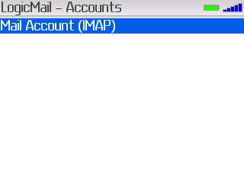
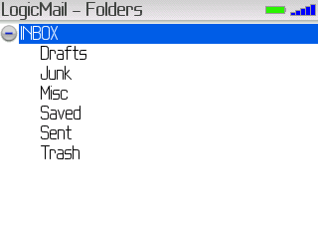
32. Click on Mail Account (IMAP) and choose Select
31. Press Esc key To get to here
Select
33. Choose Continue when prompted “You are attempting to open a Secure connection, but the server’s certificate is not trusted.”
34. You will now see your account, and your folders should start to populate

Slide 12
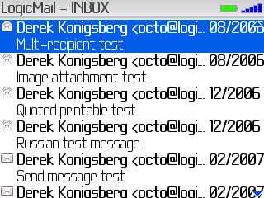
35. When in your Inbox, look for the same email that is on your AKO account

Slide 13
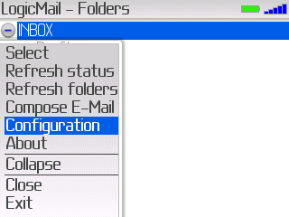
36. Since you are using IMAP, you will need to set up your sent items folder
Go to: Configuration
Select your IMAP account

Slide 14
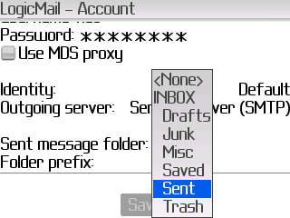
37. Select the folder you want your Sent mail saved to
NOTE: Soldier who tested for me received an error when she selected Sent. It may have been because she selected the regular AKO for outgoing mail server.
38. Save changes made, Close

Slide 15
You should now be able to check your AKO email from your BlackBerry
If you have any other questions / problems, please document them and send to me to update this presentation. I don’t own a BlackBerry, so, I can’t test this myself.
Presented by:
Michael J. Danberry
chief@militarycac.com
https://MilitaryCAC.com
Further questions: https://militarycac.com/questions.htm

