Slide 1

How to Digitally Sign a form using IBM Forms viewer (formerly Lotus Forms) and eSign (formerly ApproveIt)
Presented by: Michael J. Danberry
Last Update / Revision: 04 June 2015
I get questions often where people “freeze up” when they see No Signature when trying to sign a form. So, I decided to do these screen shots to show how to digitally sign forms.

Slide 2
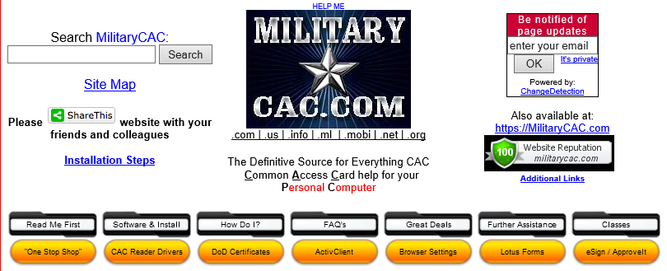

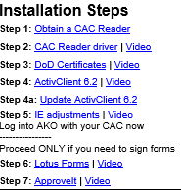
Open Internet Explorer, navigate to https://militarycac.com, click Software & Install, eSign / ApproveIt, or step 7: eSign

Slide 3
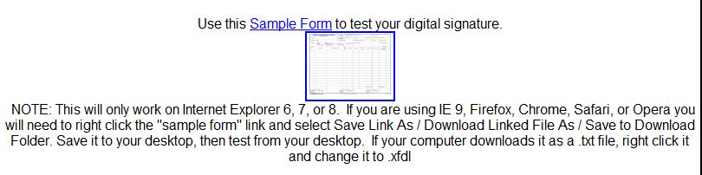
Double click the Sample Form link or thumbnail
IBM Forms Viewer / Lotus Forms (.xfdl) version
NOTE: Internet Explorer 8, 9, 10 & 11 users need to look at slides 19-20 of this guide If not, they along with: Firefox, Chrome, Safari, and Opera web browser users will receive 'gibberish' when clicking the Lotus Forms .xfdl link above. You need to right click the "sample form" link and select Save Link As / Download Linked File As / Save to Download Folder. Save it to your desktop, then test from your desktop. If your computer downloads it as a .txt file, right click it and change it to .xfdl
Please read NOTE above regarding which web browsers clicking the link will work in. Not all browsers respond the same.

Slide 4

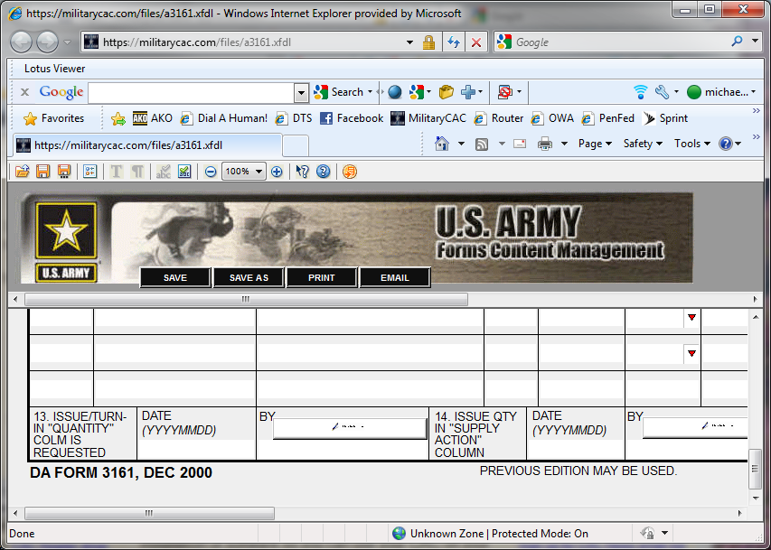
Scroll to the bottom and double click on the slanted pen

Slide 5
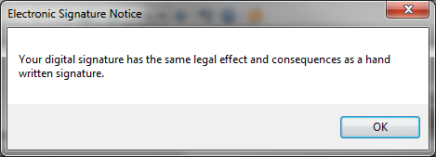
You will see this notice, Select OK

Slide 6
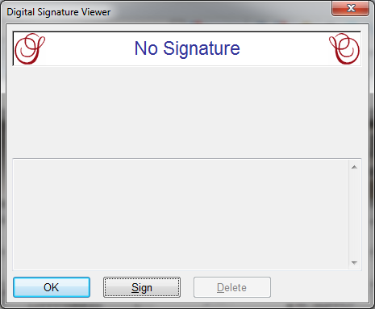
Select the word Sign
If the word Sign it gray, visit https://militarycac.com/errors2.htm#SIGN_IS_GRAY

Slide 7
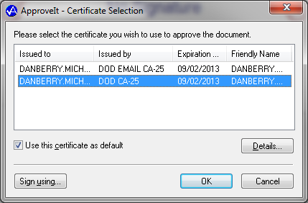
Select the certificate WITHOUT the word EMAIL in it, then select “Use this certificate as default” box, then OK

Slide 8
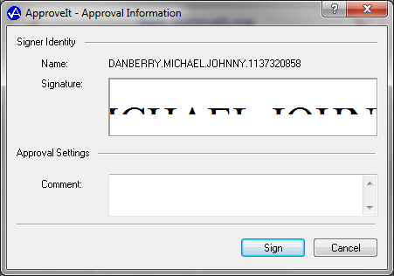
You’ll now see a Signer Identity, so Click Sign

Slide 9
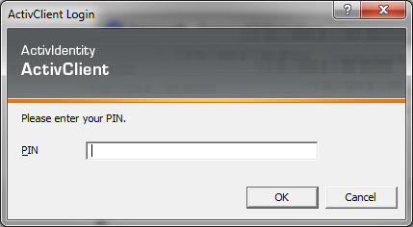
Enter your 6-8 digit CAC PIN, then OK
********

Slide 10
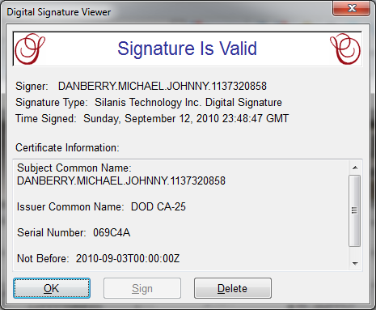
Click OK

Slide 11
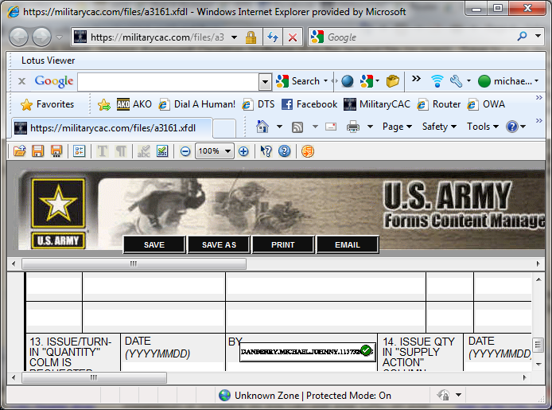
If it worked correctly, you should see your name in the digital signature block with a green circle with a white checkmark in it.

Slide 12
If the word Sign was gray and you were unable to sign
please visit: https://militarycac.com/faqs.htm#SIGN_IS_GRAY to start troubleshooting your IBM Forms, or eSign installation.
Presented by:
Michael J. Danberry
https://MilitaryCAC.com
Further questions: https://militarycac.com/questions.htm

