Slide 1

Making the new AKO webmail work faster on your computer
Presented by Michael J. Danberry
I am performing this fix on people’s computers who use AKO webmail. The former version loaded fairly fast. The new version loads very slow on some computers.
Last Review / Revision: 15 February 2015

Slide 2
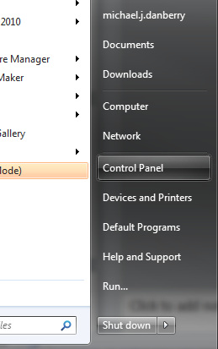
To get to Control Panel, Select Start, Control Panel

Slide 3
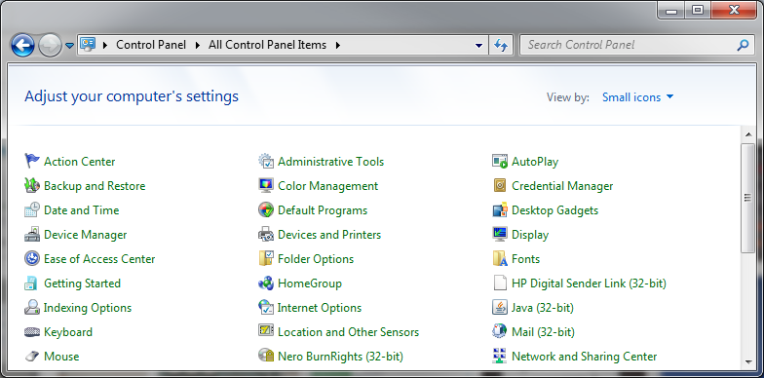
Open Control Panel and click on Java.
This image is from Windows 7 (64bit) using Small icons (which is why it has (32-bit) after it)

Slide 4
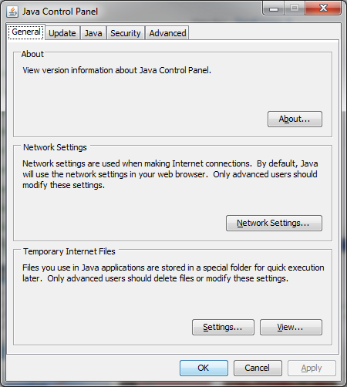
Click Settings…

Slide 5
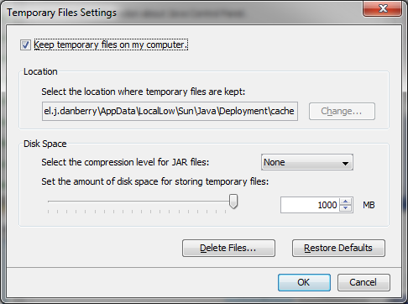
Click Delete Files…
NOTE: If after completing all steps and still having problems, come back to this page and reduce the storage amount down from 1000, something like 500 or 750 should work

Slide 6
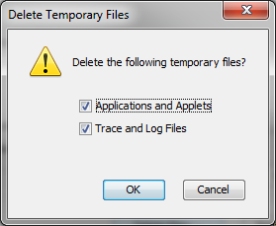
Click the OK button

Slide 7
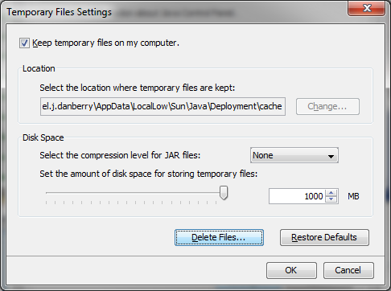
You will be returned to this screen, select OK

Slide 8
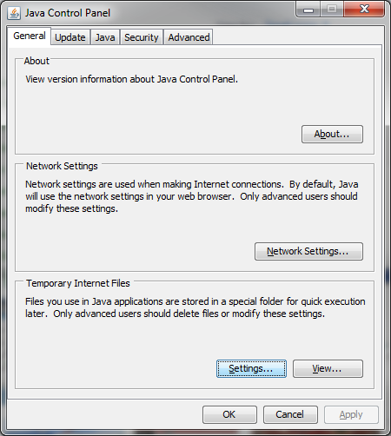
You will be returned to this screen, select OK

Slide 9

Close Control Panel

Slide 10
Try accessing webmail again
If the previous ideas did not work, please try accessing your email later and / or clearing your browser cache
https://militarycac.com/files/Making_AKO_work_with_Internet_Explorer_color.pdf
Another presentation by:
Michael J. Danberry
https://MilitaryCAC.com
Further questions: https://militarycac.com/questions.htm

