Slide 1

How to add the MilitaryCAC.com logo to your iPhone or iPad
Presented by: Michael J. Danberry
Last Revision: 4 January 2012
Now you can have the MilitaryCAC.com logo on your iPhone or iPad
https://MilitaryCAC.com
Instructions are identical for both the iPhone and iPad (other than for which images to download)

Slide 2
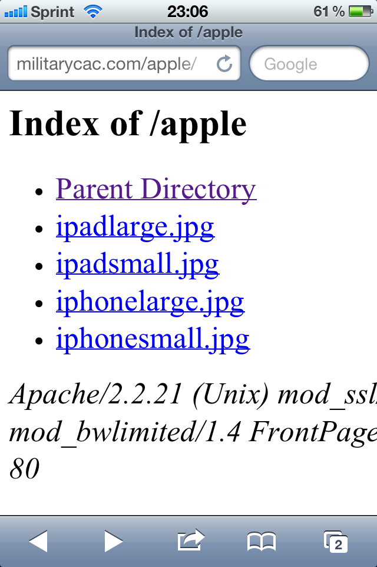
From your iPhone or iPad web browser go to: http://militarycac.com/apple/
Select the file you want to use.
(Examples can be seen on slide 7)

Slide 3

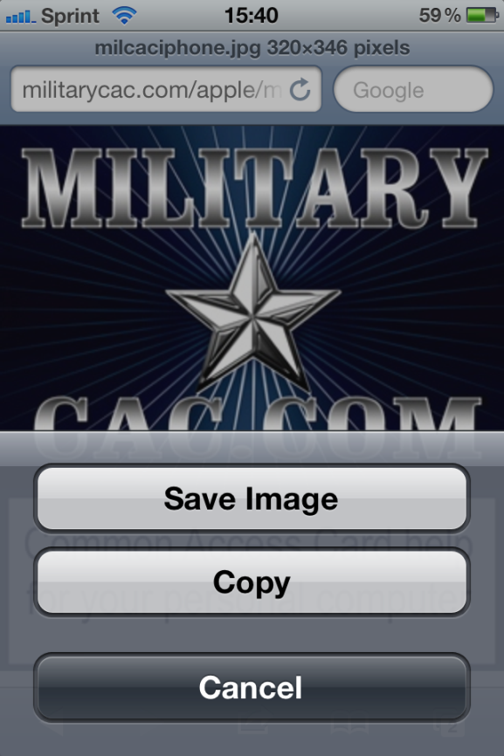
Hold your finger on the image and select Save Image
Close your web browser

Slide 4



Click Photos, Camera Roll. Select the MilitaryCAC image

Slide 5

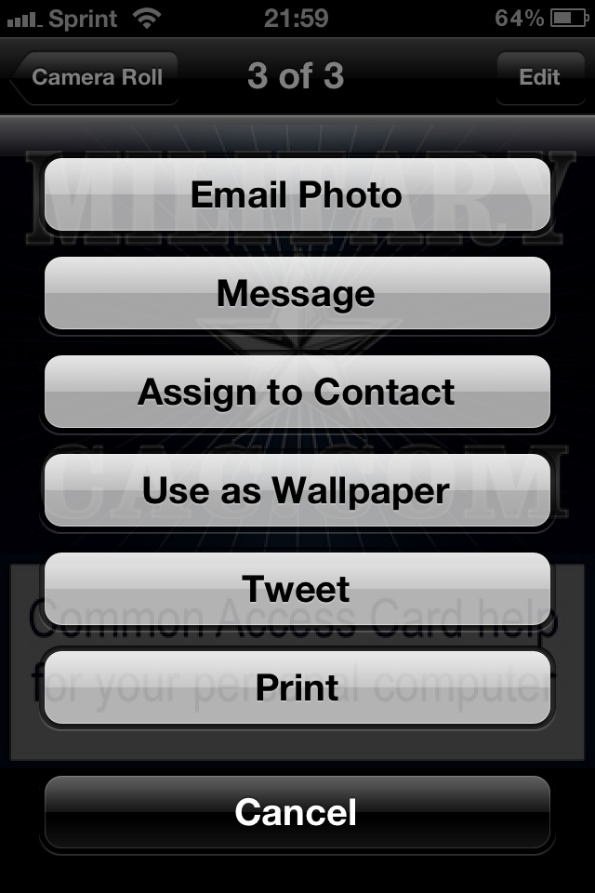
Click the little arrow, then Use as Wallpaper

Slide 6

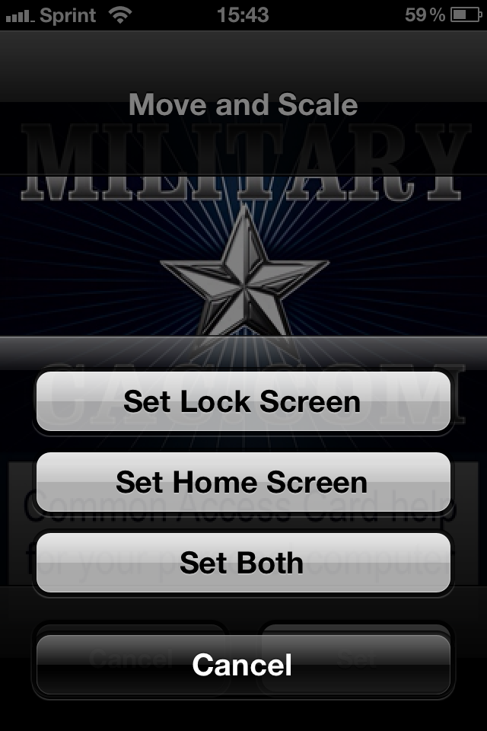
Select Set. Now choose Set Lock Screen, Set Home Screen, or Set Both

Slide 7


Examples of locked iPhone with MilitaryCAC logos

Slide 8

Example of locked iPad with MilitaryCAC logo

